Slide 1

Best First Search
LAB 6

Slide 2
Best First Search
The idea of Best First Search is to use an evaluation function to decide which adjacent is most promising and then explore.
Best First Search falls under the category of Heuristic Search or Informed Search.

Slide 3
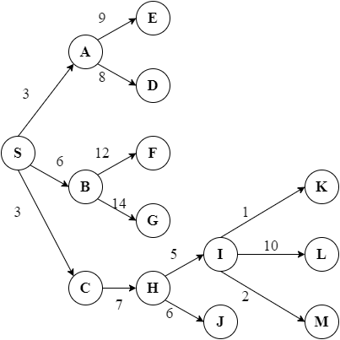
Best First Search (informed)
BFS expands a node with the lowest cost so we need to implement a priority queue to hold the nodes with their costs as priority.
Example:
Let's consider S as starting node and I as goal node.
Now our priority queue contains S.
Expand “S”
PQ [A, C , B]
C is written before B because it
has less estimation cost.
Expand A
PQ [C,B,D,E]
D has less cost estimate than E, so it is inserted first.

Slide 4
Best First Search (informed)
Expand C
PQ [B,H,D,E]
Sort Childs node with least cost.
Expand B
PQ [H,D,E,F,G]
Expand H
PQ[D,E,F,G,I]
As I was the goal node, so we return
Final Search: S,A,C,B,H,I
Note : After Adding value to Queue sort, it in Ascending order according to an estimation function

Slide 5
Best First Search (Heuristic)
In this we use a special heuristic function for searching our goal node. It is used to solve the problem quickly.
Denoted by h(n)
h(n) = estimated cost of the cheapest path from the state at node n to a goal state.
h(n) takes a node as input, but it depends only on the state at that node. For example, it might estimate the cost of the cheapest path from starting point to goal via the straight-line distance.

Slide 6
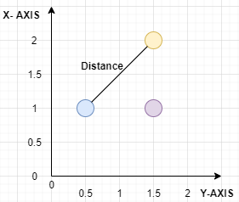
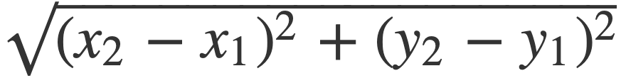
Straight Line Distance
Euclidean Distance
dist =
Distance form point blue to yellow is : 1.80

Slide 7
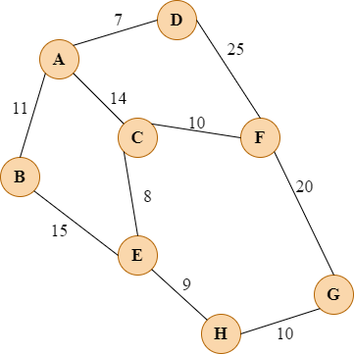
Best First Search(Heuristic)
N | h(n)
A-G | 40
B-G | 32
C-G | 25
D-G | 35
E-G | 19
F-G | 17
H-G | 10
G-G | 0
Goal Node is G
Let’s Start with node A
Expand A
PQ [C,B,D]
Expand C
PQ [F,E,B,D] #A is already visited so not added to queue again
Expand F
PQ[E,B,D]
G is goal node pop out G and terminate.
A,C,F,G

